Slide 1
Real-Time Systems
Real-Time Scheduling
Frank Drews
drews@ohio.edu
Frank Drews
Real-Time Systems

Slide 2
Characteristics of a RTS
Large and complex
OR small and embedded
  Vary from a few hundred lines of assembler or C to millions of lines of lines of high-level language code
  Concurrent control of separate system components
    Devices operate in parallel in the real-world, hence, better to model this parallelism by concurrent entities in the program
Facilities to interact with special purpose hardware
  Need to be able to program devices in a reliable and abstract way
Frank Drews
Real-Time Systems

Slide 3
Characteristics of a RTS
Extreme reliability and safety
  Embedded systems typically control the environment in which they operate
  Failure to control can result in loss of life, damage to environment or economic loss
Guaranteed response times
  We need to be able to predict with confidence the worst case response times for systems
  Efficiency is important but predictability is essential
    In RTS, performance guarantees are:
      Task- and/or class centric
      Often ensured a priori
    In conventional systems, performance is:
      System oriented and often throughput oriented
      Post-processing (… wait and see …)
Frank Drews
Real-Time Systems

Slide 4
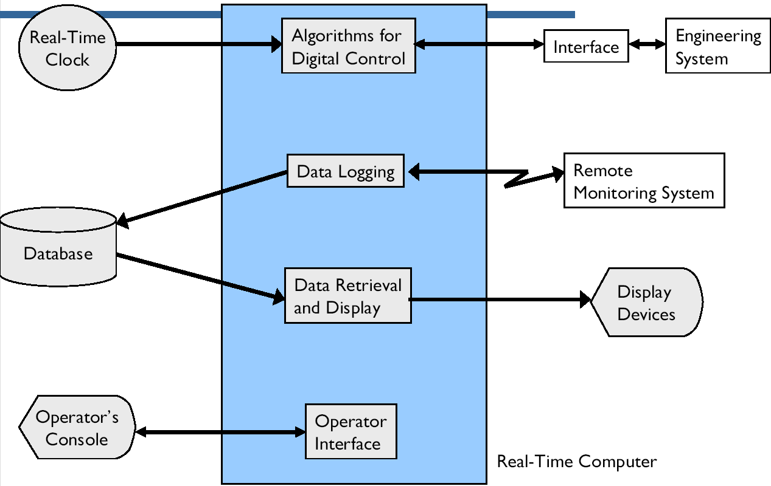
Typical Components of a RTS
Frank Drews
Real-Time Systems

Slide 5
Terminology
Scheduling
define a policy of how to order tasks such that a metric is maximized/minimized
  Real-time: guarantee hard deadlines, minimize the number of missed deadlines, minimize lateness
Dispatching
carry out the execution according to the schedule
  Preemption, context switching, monitoring, etc.
Admission Control
Filter tasks coming into the systems and thereby make sure the admitted workload is manageable
Allocation
designate tasks to CPUs and (possibly) nodes. Precedes scheduling
Frank Drews
Real-Time Systems

Slide 6
Preliminaries
Scheduling is the issue of ordering the use of system resources
  A means of predicting the worst-case behaviour of the system
activation
dispatching
termination
execution
preemption
Frank Drews
Real-Time Systems

Slide 7
Non-Real-Time Scheduling
Primary Goal: maximize performance
Secondary Goal: ensure fairness
Typical metrics:
  Minimize response time
  Maximize throughput
  E.g., FCFS (First-Come-First-Served), RR (Round-Robin)
Frank Drews
Real-Time Systems

Slide 8
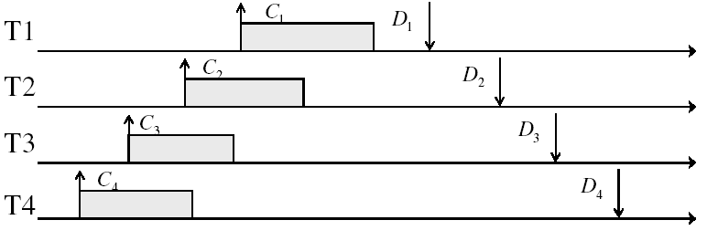
Example: Workload Characteristics
Tasks are preemptable, independent with arbitrary arrival (=release) times
Times have deadlines (D) and known computation times (C)
Tasks execute on a uni-processor system
Example Setup
Frank Drews
Real-Time Systems

Slide 9
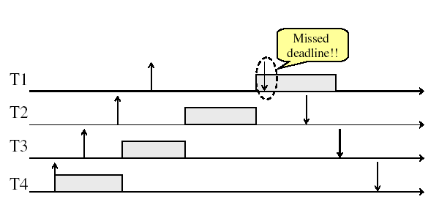
Example:
Non-preemptive FCFS Scheduling
Frank Drews
Real-Time Systems

Slide 10
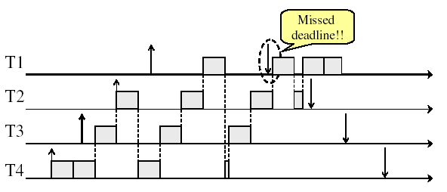
Example:
Round-Robin Scheduling
Frank Drews
Real-Time Systems

Slide 11
Real-Time Scheduling
Primary goal: ensure predictability
Secondary goal: ensure predictability
Typical metrics:
  Guarantee miss ration = 0 (hard real-time)
  Guarantee Probability(missed deadline) < X% (firm real-time)
  Minimize miss ration / maximize completion ration (firm real-time)
  Minimize overall tardiness; maximize overall usefulness (soft real-time)
E.g., EDF (Earliest Deadline First, LLF (Least Laxity First), RMS (Rate-Monotonic Scheduling), DM (Deadline Monotonic Scheduling)
Recall: Real-time is about enforcing predictability, and does not equal to fast computing!!!
Frank Drews
Real-Time Systems

Slide 12
Scheduling: Problem Space
Uni-processor / multiprocessor / distributed system
Periodic / sporadic /aperiodic tasks
Independent / interdependant tasks
Preemptive / non-preemptive
Tick scheduling / event-driven scheduling
Static (at design time) / dynamic (at run-time)
Off-line (pre-computed schedule), on-line (scheduling decision at runtime)
Handle transient overloads
Support Fault tolerance
Frank Drews
Real-Time Systems

Slide 13
Task Assignment and Scheduling
Cyclic executive scheduling (-> later)
Cooperative scheduling
  scheduler relies on the current process to give up the CPU before it can start the execution of another process
A static priority-driven scheduler can preempt the current process to start a new process. Priorities are set pre-execution
  E.g., Rate-monotonic scheduling (RMS), Deadline Monotonic scheduling (DM)
A dynamic priority-driven scheduler can assign, and possibly also redefine, process priorities at run-time.
  E.g., Earliest Deadline First (EDF), Least Laxity First (LLF)
Frank Drews
Real-Time Systems

Slide 14
Simple Process Model
Fixed set of processes (tasks)
Processes are periodic, with known periods
Processes are independent of each other
System overheads, context switches etc, are ignored (zero cost)
Processes have a deadline equal to their period
  i.e., each process must complete before its next release
Processes have fixed worst-case execution time (WCET)
Frank Drews
Real-Time Systems

Slide 15

Terminology: Temporal Scope of a Task
C - Worst-case execution time of the task
D - Deadline of tasks, latest time by which the task
should be complete
R - Release time
n - Number of tasks in the system
- Priority of the task
P - Minimum inter-arrival time (period) of the task
      Periodic: inter-arrival time is fixed
      Sporadic: minimum inter-arrival time
      Aperiodic: random distribution of inter-arrival times
J - Release jitter of a process
Frank Drews
Real-Time Systems

Slide 16
Performance Metrics
Completion ratio / miss ration
Maximize total usefulness value (weighted sum)
Maximize value of a task
Minimize lateness
Minimize error (imprecise tasks)
Feasibility (all tasks meet their deadlines)
Frank Drews
Real-Time Systems

Slide 17
Scheduling Approaches (Hard RTS)
Off-line scheduling / analysis (static analysis + static scheduling)
  All tasks, times and priorities given a priori (before system startup)
  Time-driven; schedule computed and hardcoded (before system startup)
  E.g., Cyclic Executives
  Inflexible
  May be combined with static or dynamic scheduling approaches
Fixed priority scheduling (static analysis + dynamic scheduling)
  All tasks, times and priorities given a priori (before system startup)
  Priority-driven, dynamic(!) scheduling
    The schedule is constructed by the OS scheduler at run time
  For hard / safety critical systems
  E.g., RMA/RMS (Rate Monotonic Analysis / Rate Monotonic Scheduling)
Dynamic priority schededuling
  Tasks times may or may not be known
  Assigns priorities based on the current state of the system
  For hard / best effort systems
  E.g., Least Completion Time (LCT), Earliest Deadline, First (EDF), Least Slack Time (LST)
Frank Drews
Real-Time Systems

Slide 18
Cyclic Executive Approach
Clock-driven (time-driven) scheduling algorithm
Off-line algorithm
Minor Cycle (e.g. 25ms) - gcd of all periods
Major Cycle (e.g. 100ms) - lcm of all periods
Construction of a cyclic executive is equivalent to bin packing
Process | Period | Comp. Time
A | 25 | 10
B | 25 | 8
C | 50 | 5
D | 50 | 4
E | 100 | 2
Frank Drews
Real-Time Systems

Slide 19
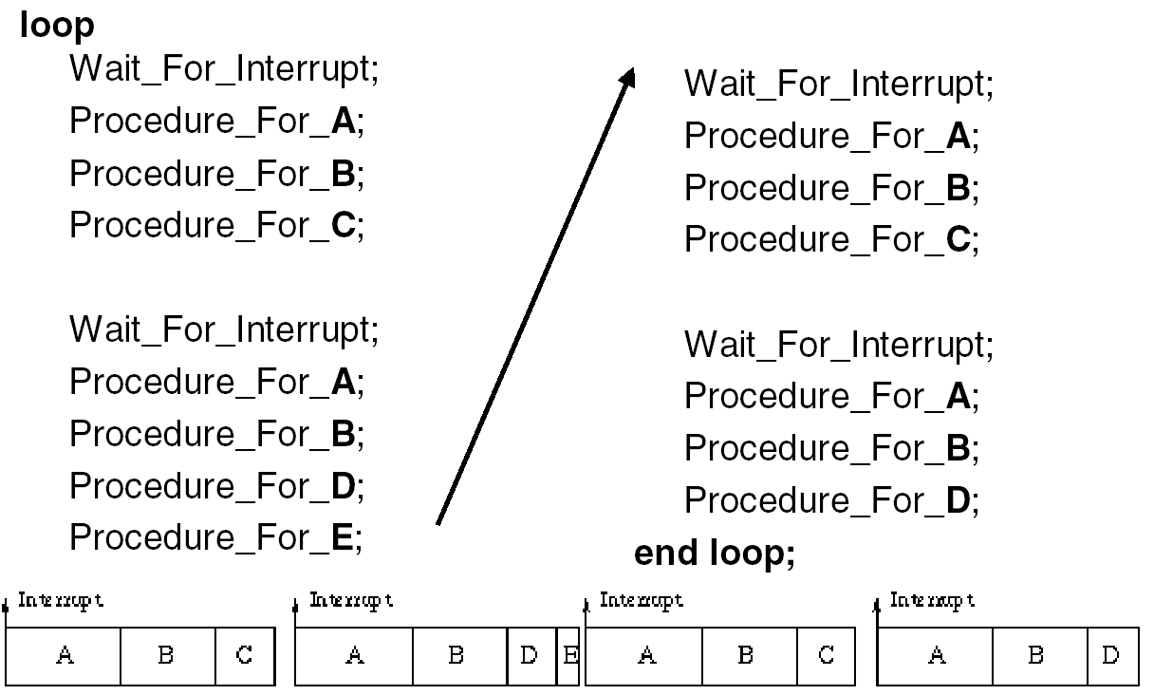
Cyclic Executive (cont.)
Frank Drews
Real-Time Systems

Slide 20
Cyclic Executive: Observations
No actual processes exist at run-time
  Each minor cycle is just a sequence of procedure calls
The procedures share a common address space and can thus pass data between themselves.
  This data does not need to be protected (via semaphores, mutexes, for example) because concurrent access is not possible
All ‘task’ periods must be a multiple of the minor cycle time
Frank Drews
Real-Time Systems

Slide 21
Cyclic Executive: Disadvantages
With the approach it is difficult to:
incorporate sporadic processes;
incorporate processes with long periods;
  Major cycle time is the maximum period that can be accommodated without secondary schedules (=procedure in major cycle that will call a secondary procedure every N major cycles)
construct the cyclic executive, and
handle processes with sizeable computation times.
  Any ‘task’ with a sizeable computation time will need to be split into a fixed number of fixed sized procedures.
Frank Drews
Real-Time Systems

Slide 22
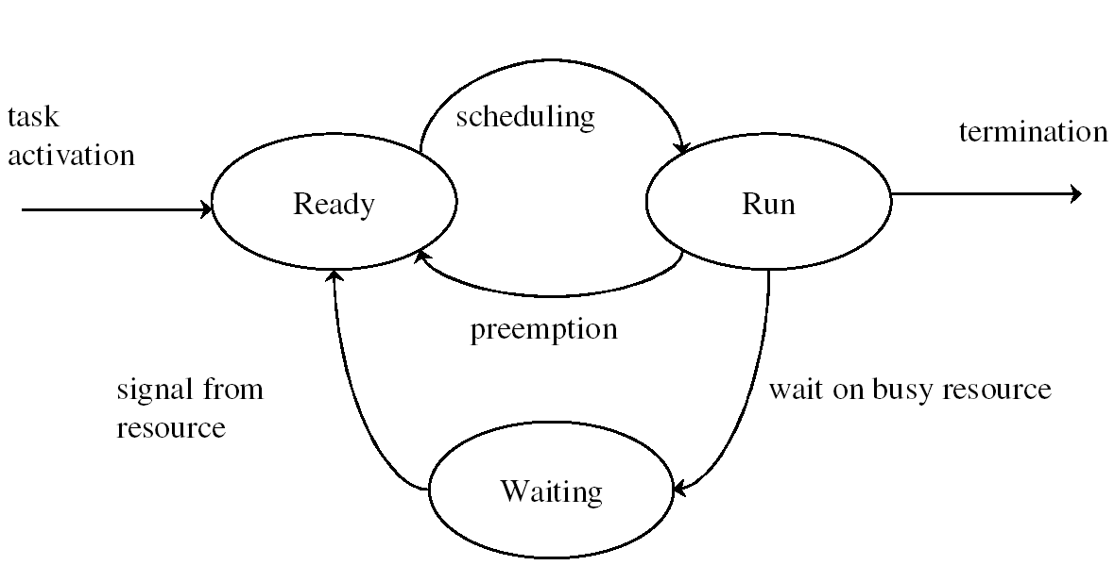
Online Scheduling
Frank Drews
Real-Time Systems

Slide 23
Schedulability Test
Test to determine whether a feasible schedule exists
Sufficient Test
  If test is passed, then tasks are definitely schedulable
  If test is not passed, tasks may be schedulable, but not necessarily
Necessary Test
  If test is passed, tasks may be schedulable, but not necessarily
  If test is not passed, tasks are definitely not schedulable
Exact Test (= Necessary + Sufficient)
  The task set is schedulable if and only if it passes the test.
Frank Drews
Real-Time Systems

Slide 24




Rate Monotonic Analysis: Assumptions
A1: Tasks are periodic (activated at a constant rate).
Period = Intervall between two consequtive activations of task
A2: All instances of a periodic task have
the same computation time
A3: All instances of a periodic task have the same relative deadline,
which is equal to the period
A4: All tasks are independent
(i.e., no precedence constraints and no resource constraints)
Implicit assumptions:
A5: Tasks are preemptable
A6: No task can suspend itself
A7: All tasks are released as soon as they arrive
A8: All overhead in the kernel is assumed to be zero (or part of )
Frank Drews
Real-Time Systems

Slide 25
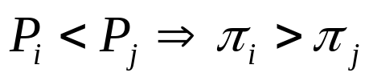
Rate Monotonic Scheduling: Principle
Principle
Each process is assigned a (unique) priority based on its period (rate); always execute active job with highest priority
The shorter the period the higher the priority
( 1 = low priority)
W.l.o.g. number the tasks in reverse order of priority
Process | Period | Priority | Name
A | 25 | 5 | T1
B | 60 | 3 | T3
C | 42 | 4 | T2
D | 105 | 1 | T5
E | 75 | 2 | T4
Frank Drews
Real-Time Systems

Slide 26
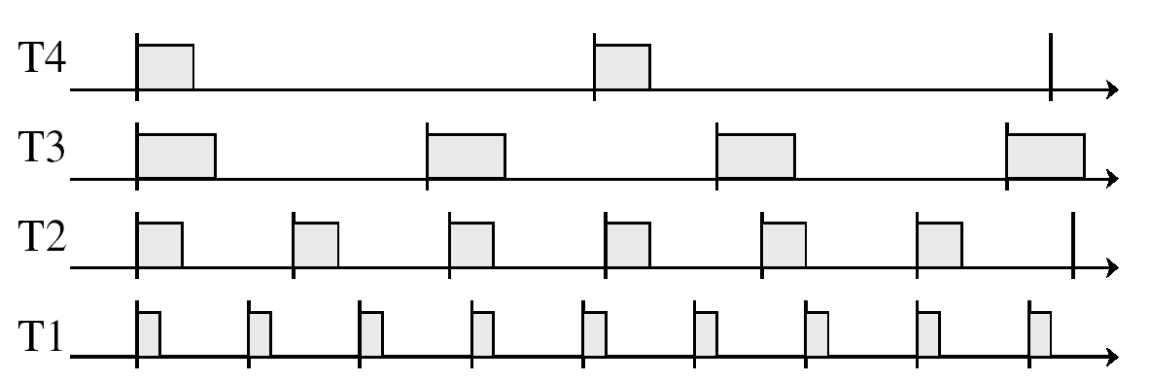
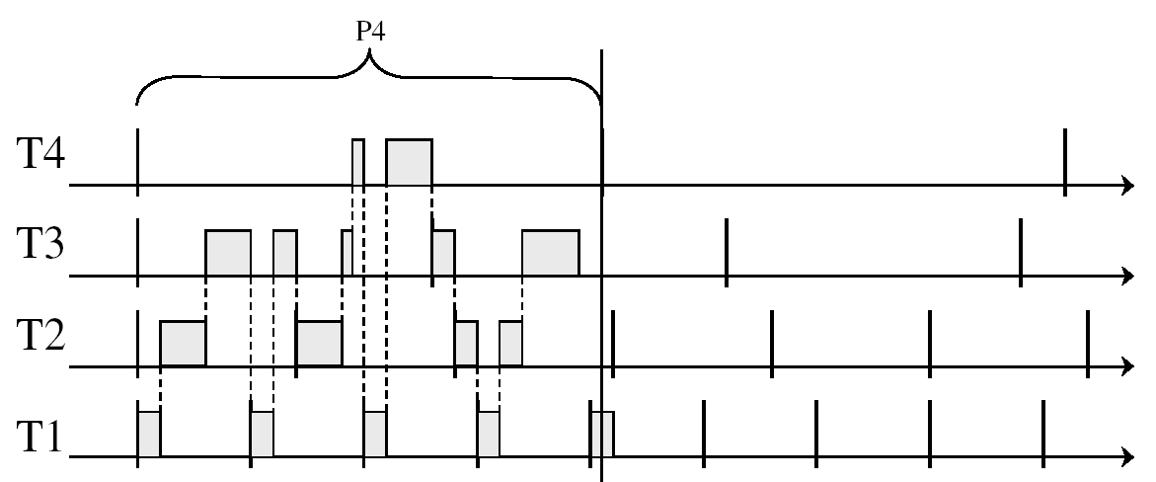
Example: Rate Monotonic Scheduling
Example instance
RMA - Gant chart
Frank Drews
Real-Time Systems

Slide 27





Example: Rate Monotonic Scheduling
Deadline Miss
0
5
10
15
response time of job
Frank Drews
Real-Time Systems

Slide 28
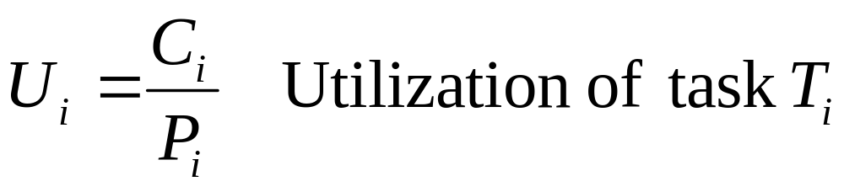
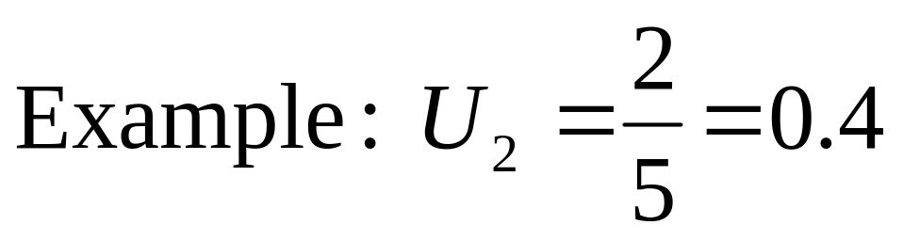
Utilization
0
5
10
15
Frank Drews
Real-Time Systems

Slide 29


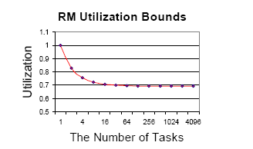
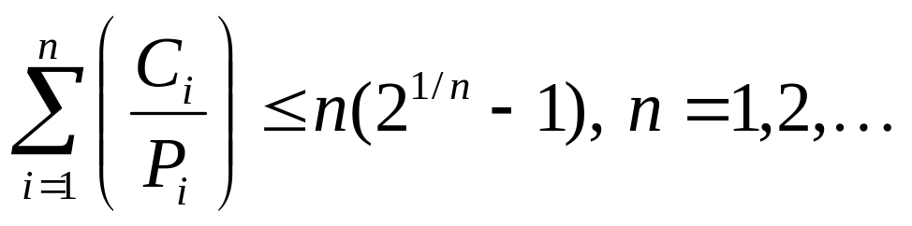



RMA: Schedulability Test #1
Theorem (Utilization-based Schedulability Test):
A periodic task set with
is schedulable by the rate monotonic scheduling algorithm if
This schedulability test is “sufficient”!
For harmonic periods ( evenly divides ),
the utilization bound is 100%
Frank Drews
Real-Time Systems

Slide 30

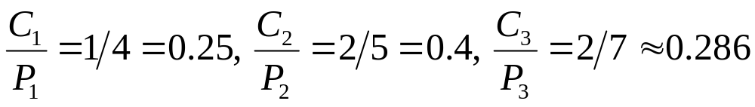
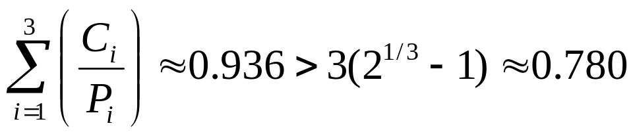
RMA Example
The schedulability test requires
Hence, we get
does not satisfy schedulability condition
Frank Drews
Real-Time Systems

Slide 31






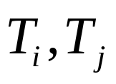
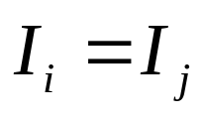
Task Phases
Phase:
release time of the (first job of) a periodic task
Two tasks are in phase if
Frank Drews
Real-Time Systems

Slide 32
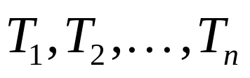
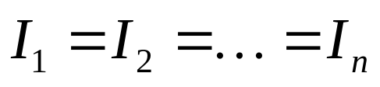
Towards Schedulability Test #2
Lemma:
The longest response time for any job of occurs for
the first job of when
The case when is called a critical instant, Because it results in the longest response time for the first job of each task.
Consequently, this creates the worst case task set phasing and leads to a criterion for the schedulability of a task set.
Frank Drews
Real-Time Systems

Slide 33


Proof of Lemma
Prove that the critical instant is the worst case
Let be the set of periodic tasks ordered by increasing periods (i.e., has the longest period, and thus, according to RMS, has the lowest priority).
Response time of is delayed due to interference of a task with higher priority:
Frank Drews
Real-Time Systems

Slide 34
Proof of Lemma
Observation: Increasing the phase of task may decrease the response time of task (but will never increase it).
Frank Drews
Real-Time Systems

Slide 35
Schedulability Test #2
Theorem: (Schedulability Test #2)
A periodic task set can be scheduled by a fixed priority scheduling algorithm if the deadline of the first job of each task is met when using the scheduling algorithm starting from a critical instant.
Proof:
Simulate the execution of the first jobs of each task and determine their response times. [Liu and Layland, 1973]
Time–Demand Analysis [Lehoczky et al, 1989, Audsley et al., 1993]
Frank Drews
Real-Time Systems

Slide 36
Sketch of Proof for RMA Schedulability Bound
Basic Idea:
Determine a “most difficult-to-schedule” system of n tasks among all possible combinations of n tasks
A task system is “difficult-to-schedule” if it is schedulable according to RMS, but it fully utilizes the CPU for some interval of time (that is, any increase in the execution time/decrease in period will render it unschedulable)
The most difficult-to-schedule task system is one with the smallest schedulable utilizations of RMS among all difficult-to-schedule task systems.
Hence, any system with a total utilization below this utilization is surely schedulable.
Frank Drews
Real-Time Systems

Slide 37
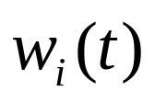

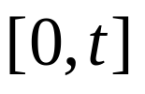
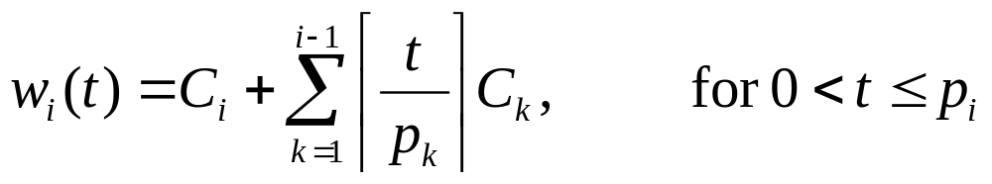
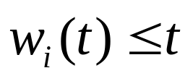
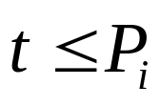
Time-Demand Function
The total processing requirement of a task in the time interval is given by
(Note that tasks are ordered by increasing priorities)
Idea: If for some then task is schedulable (which values do we need to test?)
demand
supply
Frank Drews
Real-Time Systems

Slide 38



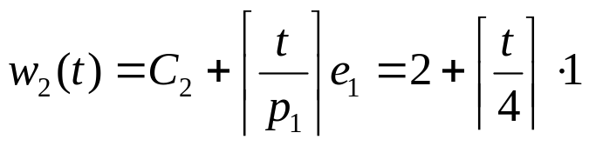
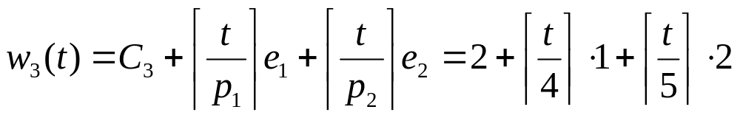




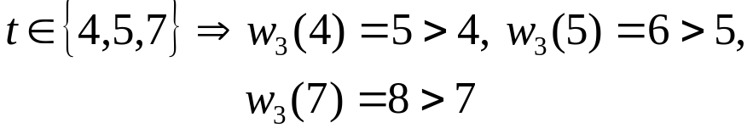
Time Demand Analysis
Example:
Test if is satisfied for
Test if is satisfied for
Test if is satisfied for
Time-Demand Function
Ok!
Ok!
Not satisfied!
Frank Drews
Real-Time Systems

Slide 39

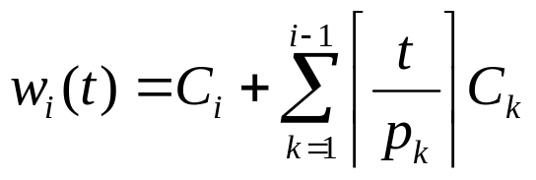




Time Demand Analysis
For each , determine the time-demand function according to
Check whether the inequality is satisfied for values of that are equal to
The time complexity of the time-demand analysis for each task is
Frank Drews
Real-Time Systems

Slide 40
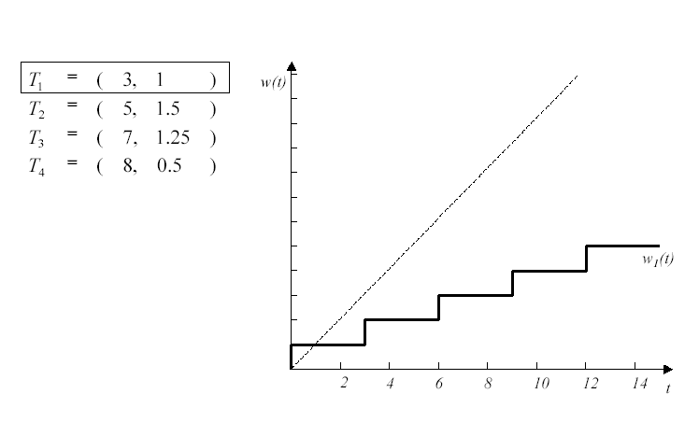
Example: Step 1
Frank Drews
Real-Time Systems

Slide 41
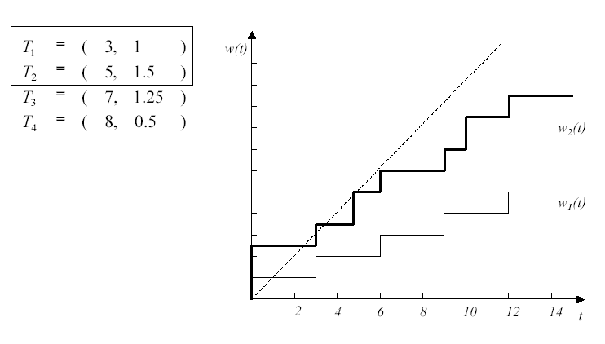
Example: Step 2
Frank Drews
Real-Time Systems

Slide 42
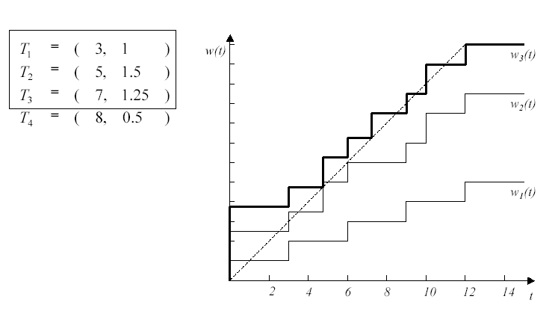
Example: Step 3
Frank Drews
Real-Time Systems

Slide 43
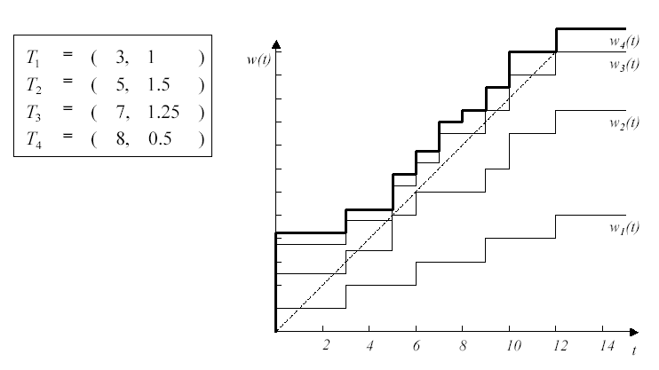
Example: Step 4
Frank Drews
Real-Time Systems

Slide 44
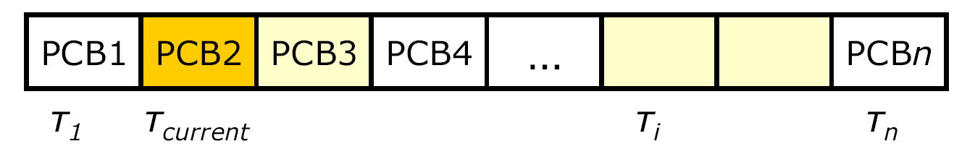

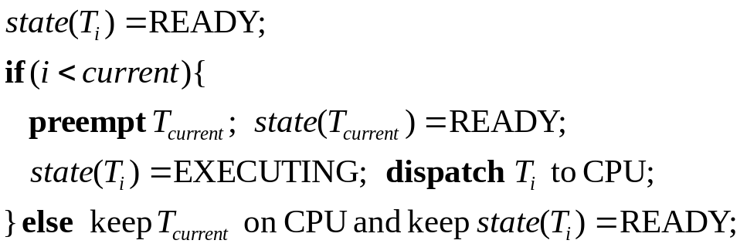
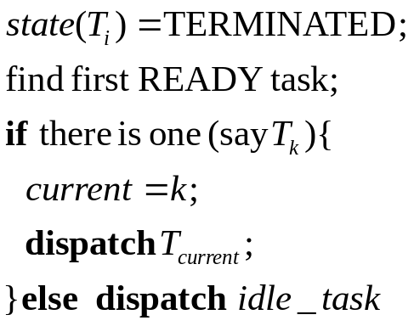
RMA Implementation
Fixed priorities ➔ use pre-sorted array of PCB references
On release of new task :
On termination of task :
Task release requires “one-shot” timers; the timer is program to expire at the next early
Frank Drews
Real-Time Systems

Slide 45


Some RMS Properties
RMS is optimal among all fixed priority scheduling algorithms for scheduling periodic tasks where the deadlines of the tasks equal their periods
RMS schedulability bound is correct if
  the actual task inter-arrival times are larger than the
  The actual task execution times are smaller than the
What happens if the actual execution times are larger than the / periods are shorter than the ?
What happens if the deadlines are larger/smaller than the ?
Frank Drews
Real-Time Systems

Slide 46
EDF: Assumptions
A1: Tasks are periodic or aperiodic.
Period = Intervall between two consequtive activations of task
A2: All instances of a periodic task have
the same computation time
A3: All instances of a periodic task have the same relative deadline,
which is equal to the period
A4: All tasks are independent
(i.e., no precedence constraints and no resource constraints)
Implicit assumptions:
A5: Tasks are preemptable
A6: No task can suspend itself
A7: All tasks are released as soon as they arrive
A8: All overhead in the kernel is assumed to be zero (or part of )
Frank Drews
Real-Time Systems

Slide 47
EDF Scheduling: Principle
Preemptive priority-based dynamic scheduling
Each task is assigned a (current) priority based on how close the absolute deadline is.
The scheduler always schedules the active task with the closest absolute deadline.
0
5
10
15
Frank Drews
Real-Time Systems

Slide 48

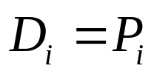
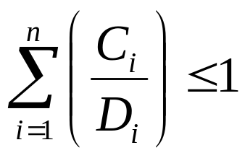
EDF: Schedulability Test
Theorem (Utilization-based Schedulability Test):
A task set with is schedulable by the earliest deadline first (EDF) scheduling algorithm if
Exact schedulability test (necessary + sufficient)
Proof: [Liu and Layland, 1973]
Frank Drews
Real-Time Systems

Slide 49
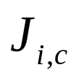


Proof of EDF Schedulability Test
Proof by contradiction:
The system is clearly not feasible if the total utilization is larger than 1.
We prove that if according to an EDF schedule, the system fails to meet some deadlines, then its total utilization has to be larger than 1.
Let us suppose that the system begins to execute at time 0 and at time t, the job of task misses its deadline.
For the moment, we assume that prior to the processor never idles (we will remove this assumption later).
Frank Drews
Real-Time Systems

Slide 50

Proof of EDF Schedulability Test
Let be the release time of the “faulting” job
Two cases:
The period of every job active at time begins at or after
The periods of some jobs active at time begin before
Frank Drews
Real-Time Systems

Slide 51











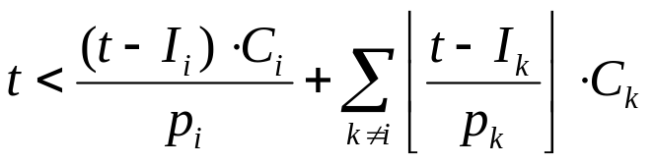
Case 1
…
…
…
0
5
10
15
misses its deadline at any current job with deadline after is not given any CPU time to execute before . The total CPU time to complete all the jobs with deadlines at or before exceeds the total time :
Frank Drews
Real-Time Systems

Slide 52





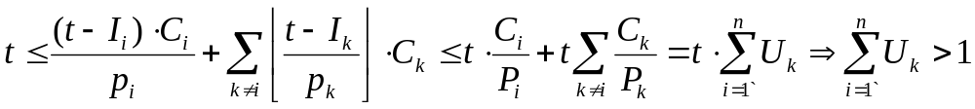
Case 1(cont’d)
…
…
…
0
5
10
15
Since and for all , and for any
Frank Drews
Real-Time Systems

Slide 53










Case 2
…
…
…
0
5
10
15
Let be the set of all tasks and the subset of tasks containing all the tasks with release time before and deadline after . Some processor time might have been given to these tasks before . Let be the end of the latest time interval that is used to execute some tasks in . We now look at the segment starting from . In this segment none of the tasks with deadlines after is given any CPU time. Let denote the release time of the first job of task in in this segment. Because misses its deadline at , we must have
Frank Drews
Real-Time Systems

Slide 54
Proof of EDF Schedulability Test
Summary:
If a task misses a deadline than the total utilization of all the tasks must be larger than 1
We can use an approach similar to Case 2 if some tasks idle before t.
Frank Drews
Real-Time Systems

Slide 55
EDF Optimality
EDF Properties
EDF is optimal with respect to feasibility (i.e., schedulability)
EDF is optimal with respect to minimizing the maximum lateness
Frank Drews
Real-Time Systems

Slide 56
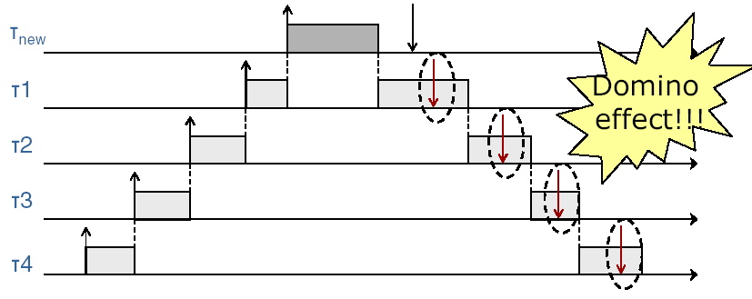
EDF Example: Domino Effect
EDF minimizes lateness of the “most tardy task” [Dertouzos, 1974]
Frank Drews
Real-Time Systems

Slide 57
Real-Time Operating Systems
GPOS
General purpose OS
Too costly for embedded applications
Increased demand on RT functionality
  Windows NT, 2K, XP,…
  Solaris, IBM AIX, HP-UX
  Linux
  Etc…
RTOS
Realtime OS
Embedded applications
Industrial robots, spacecraft, industrial control, flight control, and scientific research equipment
High degree of configurability and extensibility required
  Linux?
  RT Linux
  VxWorks
  Windows CE
  QNX
  LynxOS
  RTEMS
  OS-9
Frank Drews
Real-Time Systems

Slide 58
Real-time Operating Systems
RT systems require specific support from OS
Conventional OS kernels are inadequate w.r.t. RT
requirements
  Multitasking/scheduling
    provided through system calls
    does not take time into account (introduce unbounded delays)
  Interrupt management
    achieved by setting interrupt priority > than process priority
    increase system reactivity but may cause unbounded delays on process execution even due to unimportant interrupts
  Basic IPC and synchronization primitives
    may cause priority inversion (high priority task blocked by a low priority task)
  No concept of RT clock/deadline
Goal: Minimal Response Time
Frank Drews
Real-Time Systems

Slide 59
Real-Time Operating Systems (2)
Desirable features of a RTOS
  Timeliness
  OS has to provide mechanisms for
    time management
    handling tasks with explicit time constraints
  Predictability
    to guarantee in advance the deadline satisfaction
    to notify when deadline cannot be guaranteed
  Fault tolerance
    HW/SW failures must not cause a crash
  Design for peak load
    All scenarios must be considered
  Maintainability
Frank Drews
Real-Time Systems

Slide 60
Real-Time Operating Systems
Timeliness
  Achieved through proper scheduling algorithms
    Core of an RTOS!
Predictability
  Affected by several issues
    Characteristics of the processor (pipelinig, cache, DMA, ...)
    I/O & interrupts
    Synchronization & IPC
    Architecture
    Memory management
    Applications
    Scheduling!
Frank Drews
Real-Time Systems

Slide 61
Achieving Predictability: DMA
Direct Memory Access
  To transfer data between a device and the main memory
  Problem: I/O device and CPU share the same bus
2 possible solutions:
Cycle stealing
  The DMA steals a CPU memory cycle to execute a data transfer
  The CPU waits until the transfer is completed
  Source of non-determinism!
Time-slice method
  Each memory cycle is split in two adjacent time slots
    One for the CPU
    One for the DMA
  More costly, but more predictable!
Frank Drews
Real-Time Systems

Slide 62
Achieving Predictability: Cache
To obtain a high predictability it is better to have processors without cache
Source of non-determinism
cache miss vs. cache hit
writing vs. reading
Frank Drews
Real-Time Systems

Slide 63
Achieving Predictability: Interrupts
One of the biggest problem for predictability
Typical device driver
  <enable device interrupt>
  <wait for interrupt>
  <transfer data>
In most OS
  interrupts served with respect to fixed priority scheme
  interrupts have higher priorities than processes
  How much is the delay introduced by interrupts?
    How many interrupts occur during a task?
problem in real-time systems
  processes may be of higher importance than I/0 operation!
Frank Drews
Real-Time Systems

Slide 64
Interrupts: First Solution Attempt
Disable all interrupts, but timer interrupts
Advantages
All peripheral devices have to be handled by tasks
Data transfer by polling
Great flexibility, time for data transfers can be estimated precisely
No change of kernel needed when adding devices
Problems
Degradation of processor performance (busy wait)
Task must know low level details of the drive
Frank Drews
Real-Time Systems

Slide 65
Interrupts: Second Solution Attempt
Disable all interrupts but timer interrupts, and handle devices by special, timer-activated kernel routines
Advantages
unbounded delays due to interrupt driver eliminated
periodic device routines can be estimated in advance
hardware details encapsulated in dedicated routines
Problems
degradation of processor performance (still busy waiting within I/0 routines)
more inter-process communication than first solution
kernel has to be modified when adding devices
Frank Drews
Real-Time Systems

Slide 66
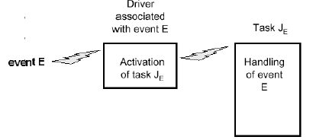
Interrupts: Third Solution Attempt
Enable external interrupts and reduce the drivers to the least possible size
Driver only activates proper task to take care of device
The task executes under direct control of OS, just like any other task
User tasks may have higher priority than device tasks
Frank Drews
Real-Time Systems

Slide 67
Interrupts: Third Solution Attempt (2)
Advantages
busy wait eliminated
unbounded delays due to unexpected device handling dramatically reduced ( not eliminated!)
remaining unbounded overhead may be estimated relatively precisely
State of the art!
Frank Drews
Real-Time Systems

Slide 68

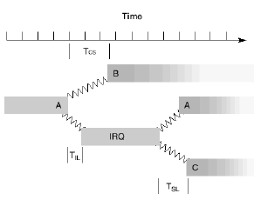


RTOS Timing Figures
Interrupt latency ( )
the time from the start of the physical interrupt to the execution of the first instruction of the interrupt service routine
Scheduling latency
(interrupt dispatch latency) ( )
the time from the execution of the last instruction of the interrupt handler to the first instruction of the task made ready by that interrupt
Context-switch time ( )
the time from the execution of the last instruction of one user-level process to the first instruction of the next user-level process
Maximum system call time
should be predictable & independent of the # of objects in the system
Frank Drews
Real-Time Systems

Slide 69
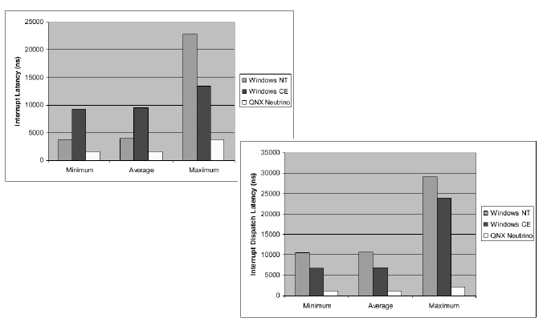
RTOS and Interrupts - Example
Frank Drews
Real-Time Systems

Slide 70
Achieving predictability:
System Calls
All system calls have to be characterized by bounded execution time
  each kernel primitive should be preemptable!
  non-preemtable calls could delay the execution of critical activities → system may miss hard deadline
Frank Drews
Real-Time Systems

Slide 71
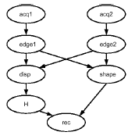
Need for Synchronization
System for recognizing objects on a conveyer belt through two camera
Tasks
  For each camera
    image acquisition acq1 and acq2
    low level image processing edge1 and edge2
Task shape to extract two-dimensional features from object contours
Task disp to compute pixel disparities
from the two images
Task H that calculates object height
from results of disp
Task rec that performs final
recognition based on H and shape
Frank Drews
Real-Time Systems

Slide 72
Achieving predictability: Semaphore
Usual semaphore mechanism not suited for real-time applications
Priority inversion problem
High priority task is blocked by low priority task for unbounded time
Solution: use special protocols
  Priority Inheritance
  Priority ceiling
Frank Drews
Real-Time Systems

Slide 73
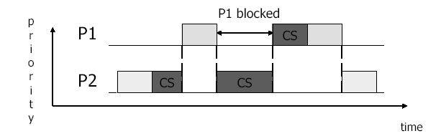
Priority Inversion
Priority(P1) > Priority (P2)
P1, P2 share a critical section (CS)
P1 must wait until P2 exits CS even if P(P1) > P(P2)
Maximum blocking time equals the time needed by P2 to execute its CS
  It is a direct consequence of mutual exclusion
In general the blocking time cannot be bounded by CS of the lower priority process
Frank Drews
Real-Time Systems

Slide 74
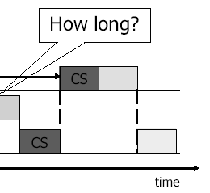
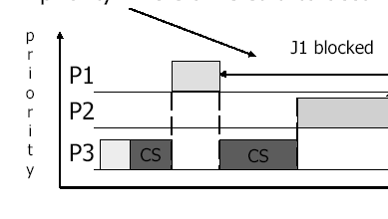
Priority inversion (2)
Typical characterization of priority inversion
  A medium-priority task preempts a lower-priority task which is using a shared resource on which a higher priority task is blocked
  If the higher-priority task would be otherwise ready to run, but a medium-priority task is currently running instead, a priority inversion is said to occur
Frank Drews
Real-Time Systems

Slide 75
Priority Inheritance
Basic protocol [Sha 1990]
A job J uses its assigned priority, unless it is in its CS and blocks higher priority jobs
In which case, J inherits PH, the highest priority of the jobs blocked by J
When J exits the CS, it resumes the priority it had at the point of entry into the CS
Priority inheritance is transitive
Advantage
Transparent to scheduler
Disadvantage
Deadlock possible in the case of bad use of semaphores
Chained blocking: if P accesses n resources locked by processes with lower priorities, P must wait for n CS
Frank Drews
Real-Time Systems

Slide 76
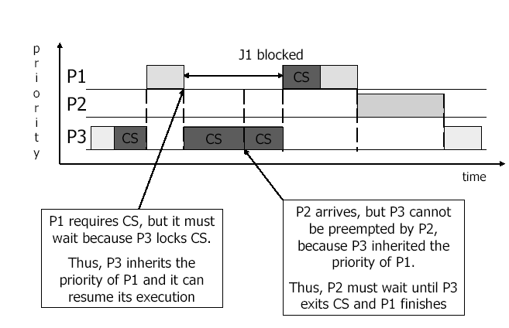
Priority Inheritance (2)
Frank Drews
Real-Time Systems

Slide 77
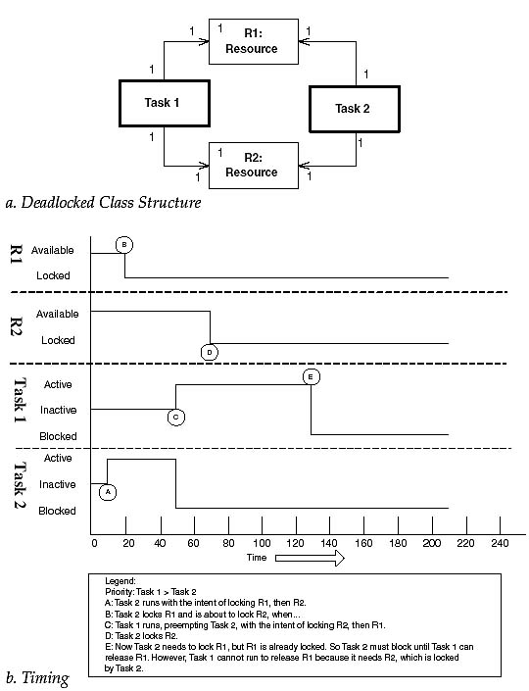

Priority Inheritance (3)
Deadlocks
Frank Drews
Real-Time Systems

Slide 78
Priority Inheritance (4):
Chained Blocking
A weakness of the priority inheritance protocol is that it does not prevent chained blocking.
Suppose a medium priority thread attempts to take a mutex owned by a low priority thread, but while the low priority thread's priority is elevated to medium by priority inheritance, a high priority thread becomes runnable and attempts to take another mutex already owned by the medium priority thread. The medium priority thread's priority is increased to high, but the high priority thread now must wait for both the low priority thread and the medium priority thread to complete before it can run again.
The chain of blocking critical sections can extend to include the critical sections of any threads that might access the same mutex. Not only does this make it much more difficult for the system designer to compute overhead, but since the system designer must compute the worst case overhead, the chained blocking phenomenon may result in a much less efficient system.
These blocking factors are added into the computation time for tasks in the RMA analysis, potentially rendering the system unschedulable.
Frank Drews
Real-Time Systems

Slide 79
Priority Ceiling
In priority ceiling protocol, each resource is assigned a priority ceiling, which is a priority equal to the highest priority of any task which may lock the resource.
A task T is allowed to enter a critical section only if its assigned priority is higher than the priority ceilings of all semaphores currently locked by tasks other than T.
Task T runs at its assigned priority unless it is in a critical section and blocks higher priority tasks.
When a task exits the critical section it resumes the priority it had at the point of entry into the critical section.
Prevents Deadlocks and Chained Blocking
Frank Drews
Real-Time Systems

Slide 80

Priority Ceiling (2)
p0>p1>p2
Frank Drews
Real-Time Systems

Slide 81







Schedulability Test for the Priority Ceiling Protocol
Sufficient Schedulability Test [Sha90]
Assume a set of periodic tasks with periods and computation times . We denote the worst-case blocking time of task by lower priority tasks by . The set of periodic tasks can be scheduled, if
Frank Drews
Real-Time Systems

Slide 82
Achieving predictability: Memory Management
Avoid non-deterministic delays
No conventional demand paging (page fault handling!)
  Page fault & page replacement may cause unpredictable delays
  May use selective page locking to increase determinism
Typically used
  Memory segmentation
  Static partitioning
    if applications require similar amounts of memory
Problems
  flexibility reduced in dynamic environment
    careful balancing required between predictabiliy and flexibility
Frank Drews
Real-Time Systems

Slide 83
Achieving predictability: Memory Applications
Current programming languages not expressive enough to prescribe precise timing
  Need of specific RT languages
Desirable features
  no dynamic data structures
    prevent the possibility of correctly predict time needed to create and destroy dynamic structures
  no recursion
    Impossible/difficult estimation of execution time for recursive programs
  only time-bound loops
    to estimate the duration of cycles
Example of RT programming language
  Real-Time Concurrent C
  Real-Time Euclid
  Real-Time Java
Frank Drews
Real-Time Systems

Slide 84
Priority Servers
We’ve already talked about periodic task scheduling
  dynamic vs. static scheduling
  EDF vs. RMA
In most real-time applications there are
  both periodic and aperiodic tasks
    typically periodic tasks are time-driven, hard real-time
    typically aperiodic tasks are event-driven, soft or hard RT
Objectives
  1. Guarantee hard RT tasks
  2. Provide good average response time for soft RT tasks
Frank Drews
Real-Time Systems

Slide 85
Handling Periodic and Aperiodic Tasks
Solutions
  Immediate service
  Background scheduling
  Aperiodic servers
    Static priority servers
    Dynamic priority servers
Frank Drews
Real-Time Systems

Slide 86

Immediate Service
Aperiodic request are served as soon as they arrive in the system
Minimum response times for aperiodic requests
Weak guarantees for periodic tasks
Example
Frank Drews
Real-Time Systems

Slide 87

Background Scheduling
Handle soft aperiodic tasks in the background behind periodic tasks, that is, in the processor time left after scheduling all periodic tasks
Aperiodic tasks just get assigned a priority lower than any periodic one
Organization of background scheduling:
Frank Drews
Real-Time Systems

Slide 88


Background Schedling
Example
Frank Drews
Real-Time Systems

Slide 89
Background Scheduling
Utilization factor under RM < 1
  some processor time is left, it can be used for aperiodic tasks
High periodic load
  bad response time for aperiodic tasks
Applicable only if no stringent timing requirements for aperiodic tasks
Major advantage: simplicity
Frank Drews
Real-Time Systems

Slide 90

Priority Servers
Alternative scheme to achieve more predictable aperiodic task handling
  A specific periodic task (server) services aperiodic requests
  The server is assigned a period Ts and a computation time Cs (capacity of the server)
  The server is scheduled like any other periodic task, not necessarily at lowest priority
Conceptual scheme
Frank Drews
Real-Time Systems

Slide 91
Priority Servers
Priority server are classified according to the priority scheme (of the periodic scheduler)
Static priority servers
  Polling Server
  Deferrable server
  Priority exchange
  Sporadic server
  Slack stealing
Dynamic priority servers
  Dynamic Polling Server
  Dynamic Deferrable Server
  Dynamic Sporadic Server
  Total Bandwidth Server
  Constant Bandwidth Server
Frank Drews
Real-Time Systems

Slide 92
Polling Server (PS)
At the beginning of its period
  PS is (re)-charged at its full value Cs
  PS becomes active and is ready to serve any pending aperiodic requests within the limits of its capacity Cs
If no aperiodic request pending → PS “suspends” itself until beginning of its next period
Processor time is used for periodic tasks
Cs is discharged to 0
If aperiodic task arrives just after suspension of PS it is served in the next period
If there are aperiodic request pending → PS serves them until Cs>0
Frank Drews
Real-Time Systems

Slide 93


Polling Server (2)
Example
Frank Drews
Real-Time Systems

Slide 94


Polling Server Analysis
In the worst-case, the PS behaves as a periodic task with utilization Us = Cs/Ts
Usually associated to RM for periodic tasks
Aperiodic tasks execute at the highest priority if
Ts = min (T1, … ,Tn)
Utilization bound for schedulability
For Us=0, reduces to
Frank Drews
Real-Time Systems

Slide 95
Deferrable Server
Basic approach like Polling Server
Differences
  1. DS preserves its capacity if no requests are pending at invocation of the server
  2. Capacity is maintained until server period → aperiodic requests arriving at any time are served as long as the capacity has not been exhausted
At the beginning of any server period, the capacity is replenished at its full value (as in PS)
  But no cumulation!
Frank Drews
Real-Time Systems

Slide 96

Deferrable Server (2)
Example: (DS medium priority)
Frank Drews
Real-Time Systems

Slide 97


Deferrable Server Analysis
Utilization
Comparing PS and DS
Frank Drews
Real-Time Systems

Slide 98

Comparison of Fixed Priority Servers
Frank Drews
Real-Time Systems

Slide 99
Dynamic Priority Servers
Dynamic scheduling algorithms have higher schedulability bounds than fixed priority ones
This implies higher overall schedulability
Frank Drews
Real-Time Systems

Slide 100
Dynamic Priority Servers (2)
Adaptations of static servers
  Dynamic priority exchange server
  Improved priority exchange server
  Dynamic sporadic server
Total Bandwidth Server
  Whenever an aperiodic request enters the system the total
  bandwidth of the server is immediately assigned to it, whenever possible
Frank Drews
Real-Time Systems

Slide 101

Total Bandwidth Server (TBS)
Dynamic priority server, used with EDF
  Each aperiodic request is assigned a deadline so that the server demand does not exceed a given bandwidth Us
  Aperiodic jobs are inserted in the ready queue and scheduled together with the hard tasks
Conceptual view:
Frank Drews
Real-Time Systems

Slide 102
Total Bandwidth Server (2)
Deadline assignment:
  Job Jk with computation time Ck arrives at time rk is assigned a deadline
  dk = rk + Ck / Us
To keep track of the bandwidth assigned to previous jobs, dk must be computed as
dk = max (rk , dk-1 ) + Ck / Us
Frank Drews
Real-Time Systems

Slide 103

Total Bandwidth Server (3)
Example:
Frank Drews
Real-Time Systems

